Slide 1

Yokai Slash: ART BIBLE
Art Lead: Victor
Team: Angeli, Hendrik, Katharina, Michael, Mohammad, Ole, Waiyaki, Zhu

Slide 2
Inspiration Boards
Style | Character | Enemy | Environment | Colour

Slide 3
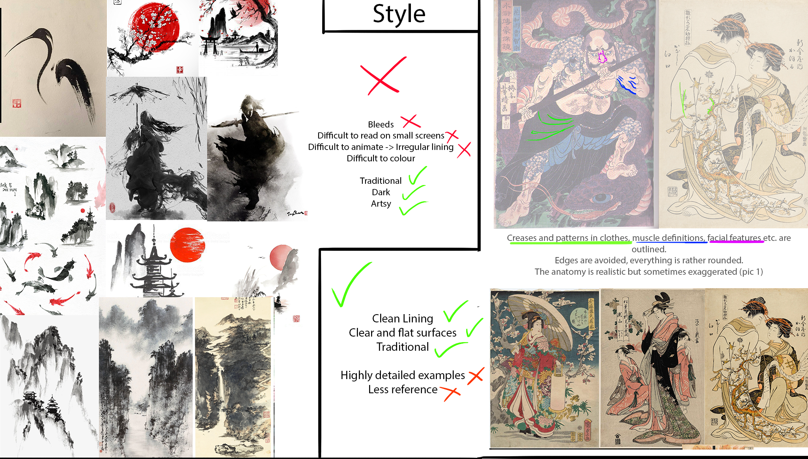

Slide 4
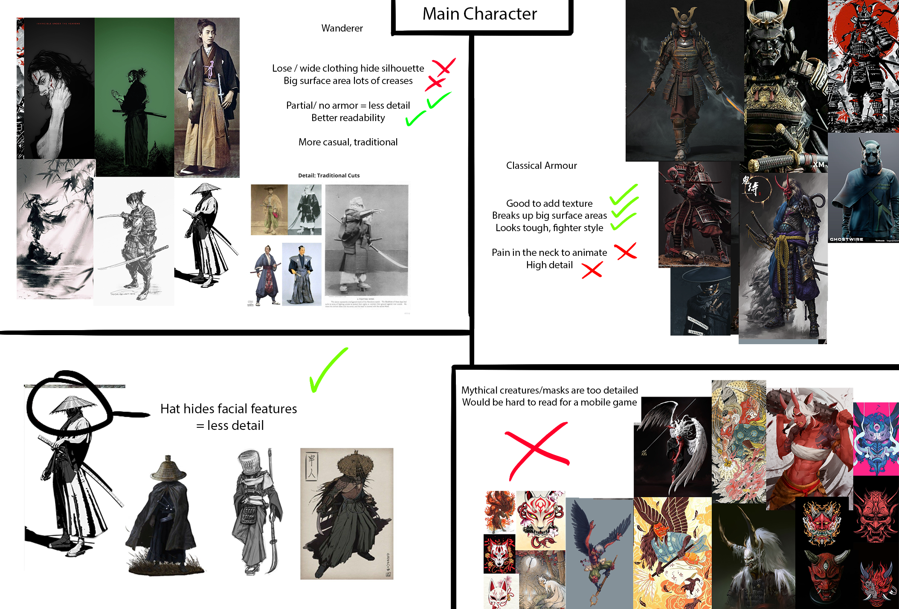

Slide 5
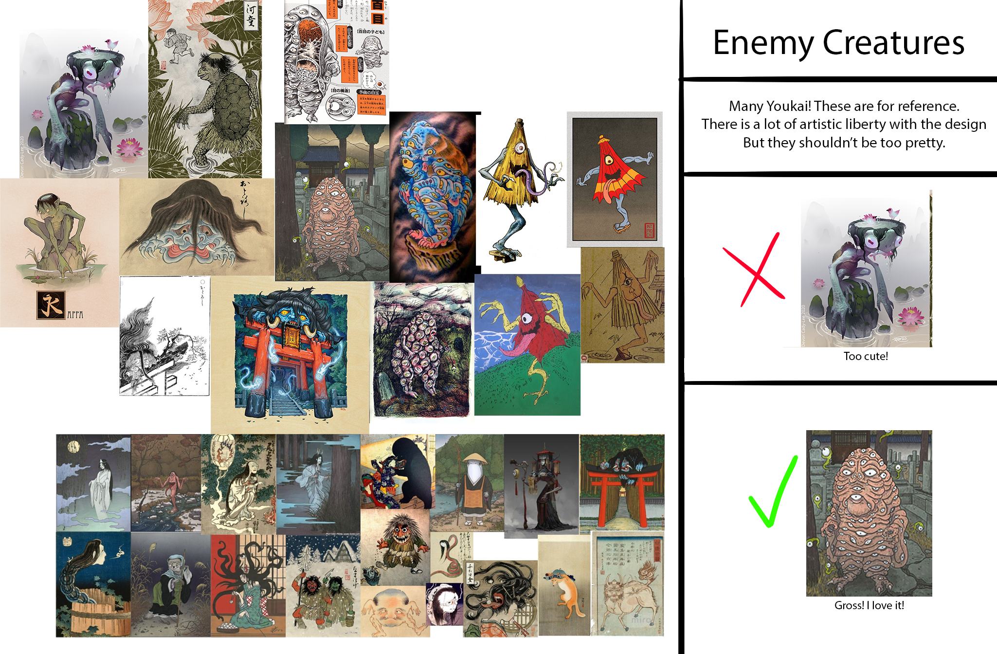

Slide 6
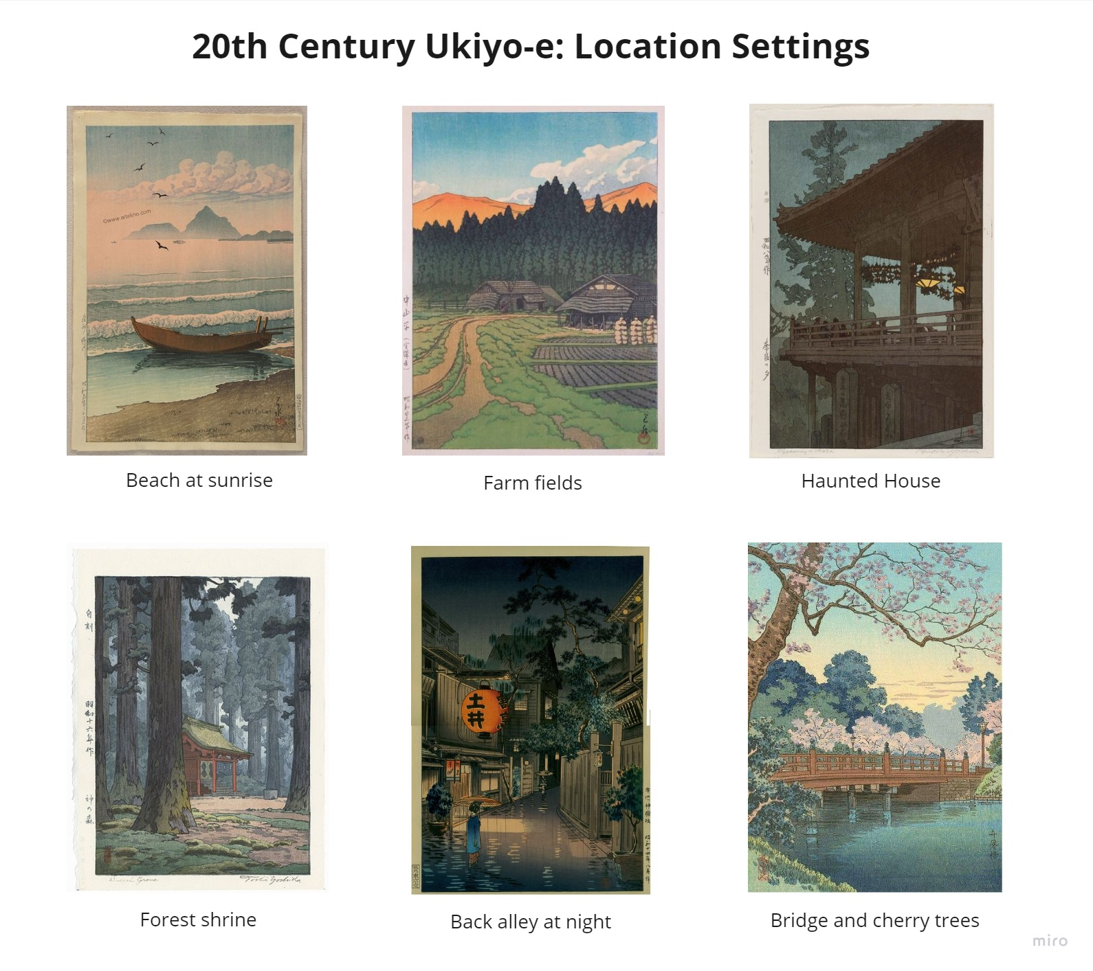
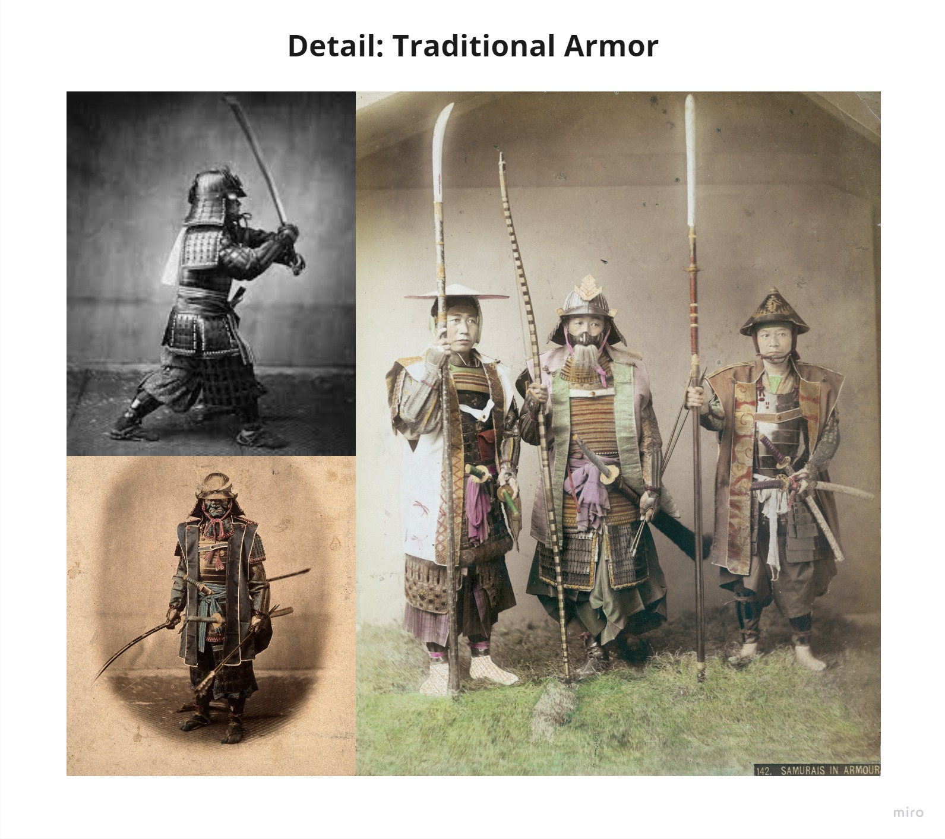
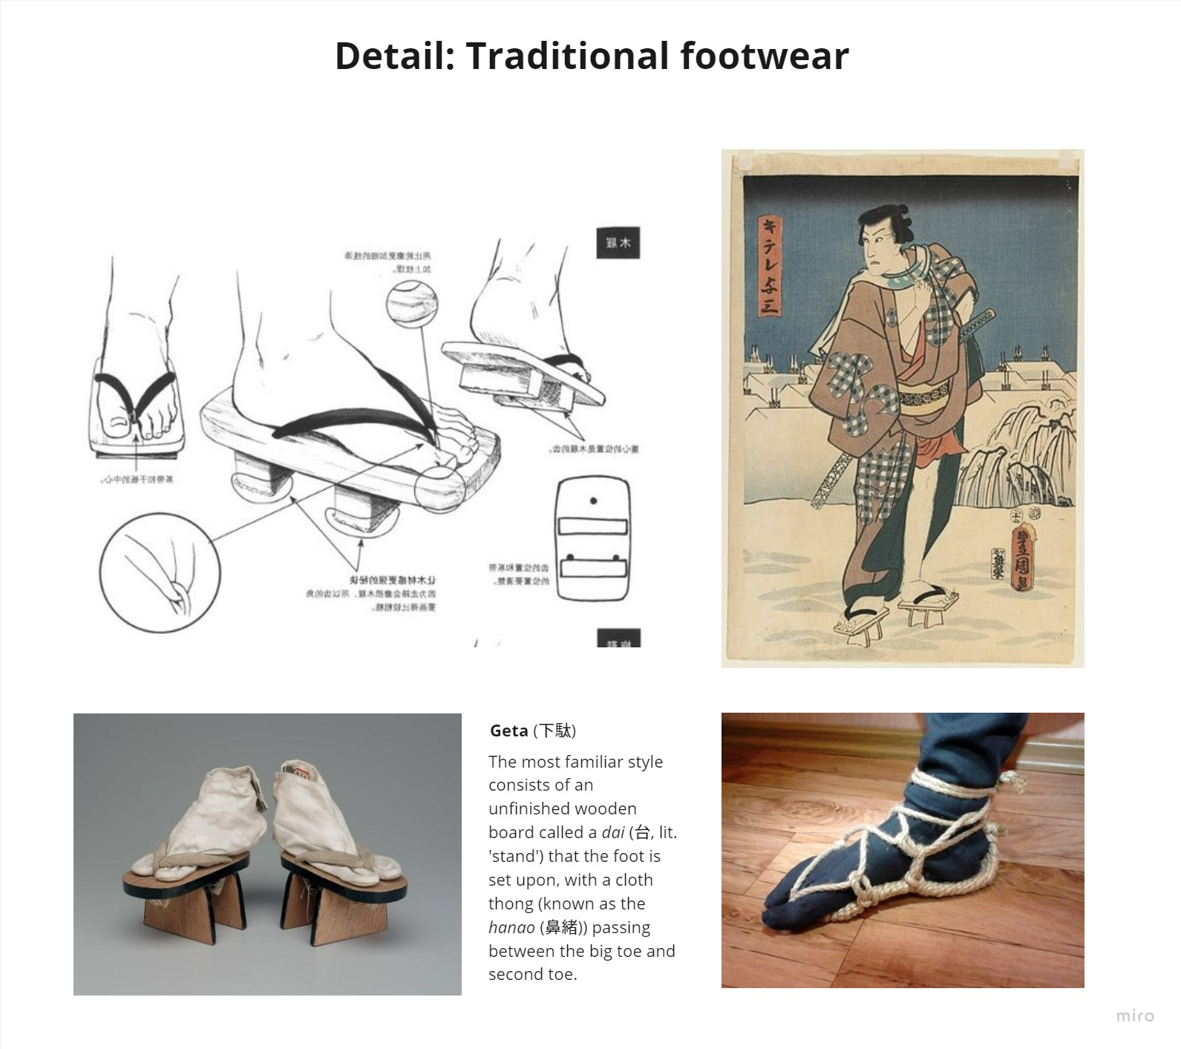
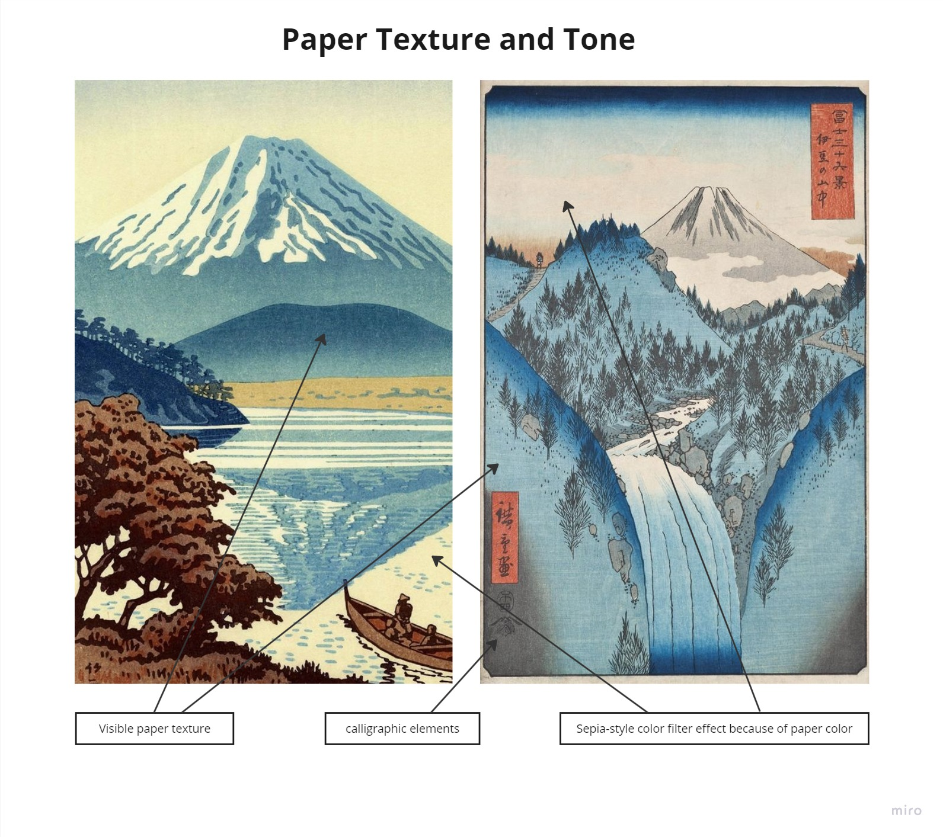
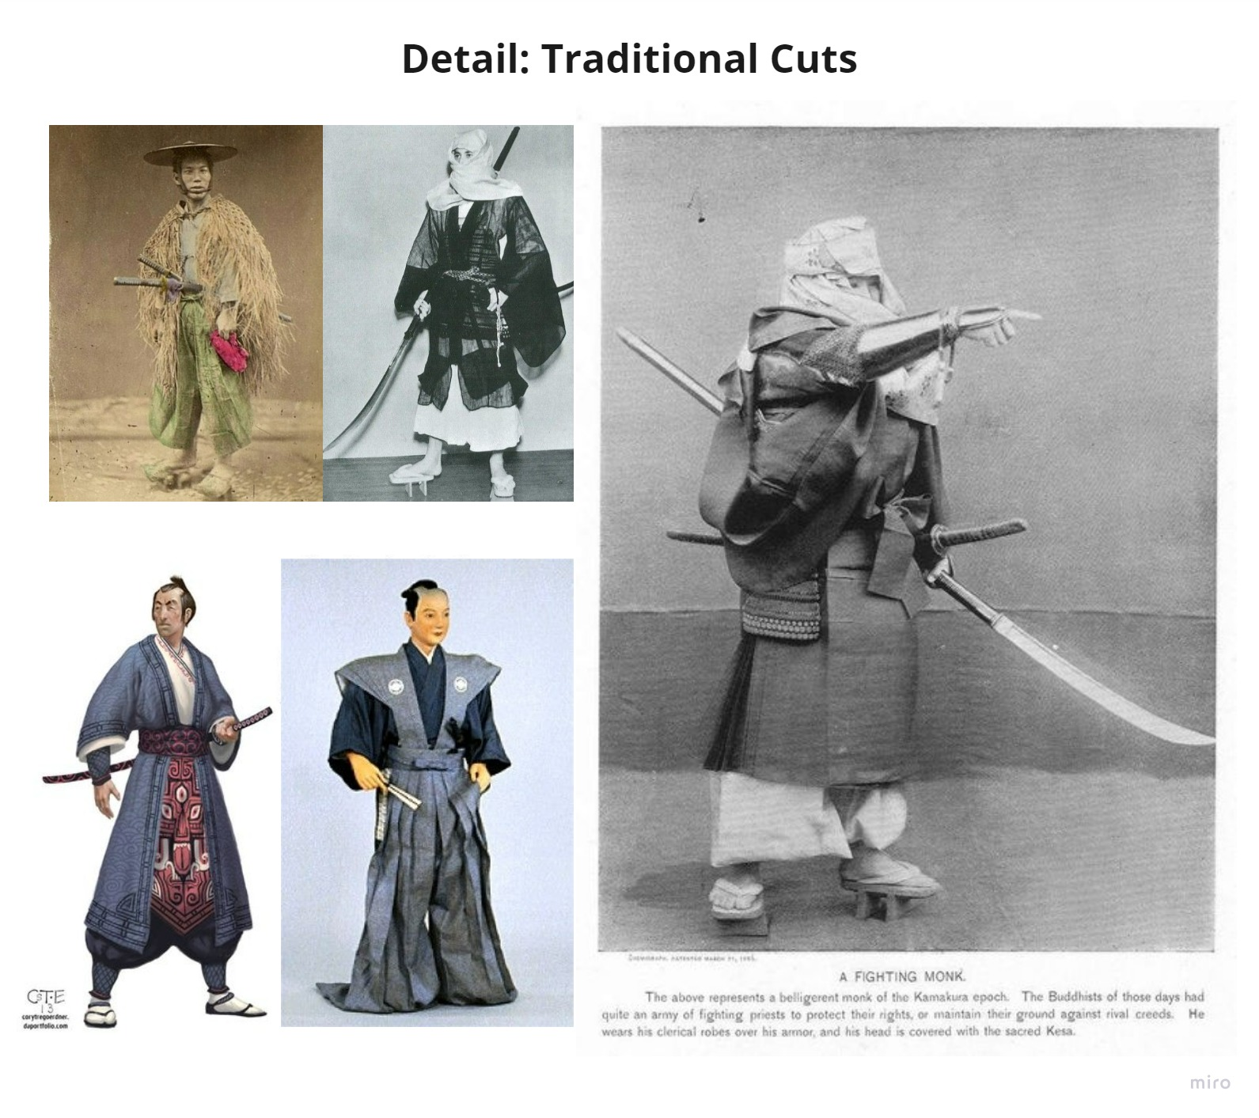

Slide 7
Colour

Slide 8
Style Guide
Characters | Level of Detail | Animation | Environment

Slide 9
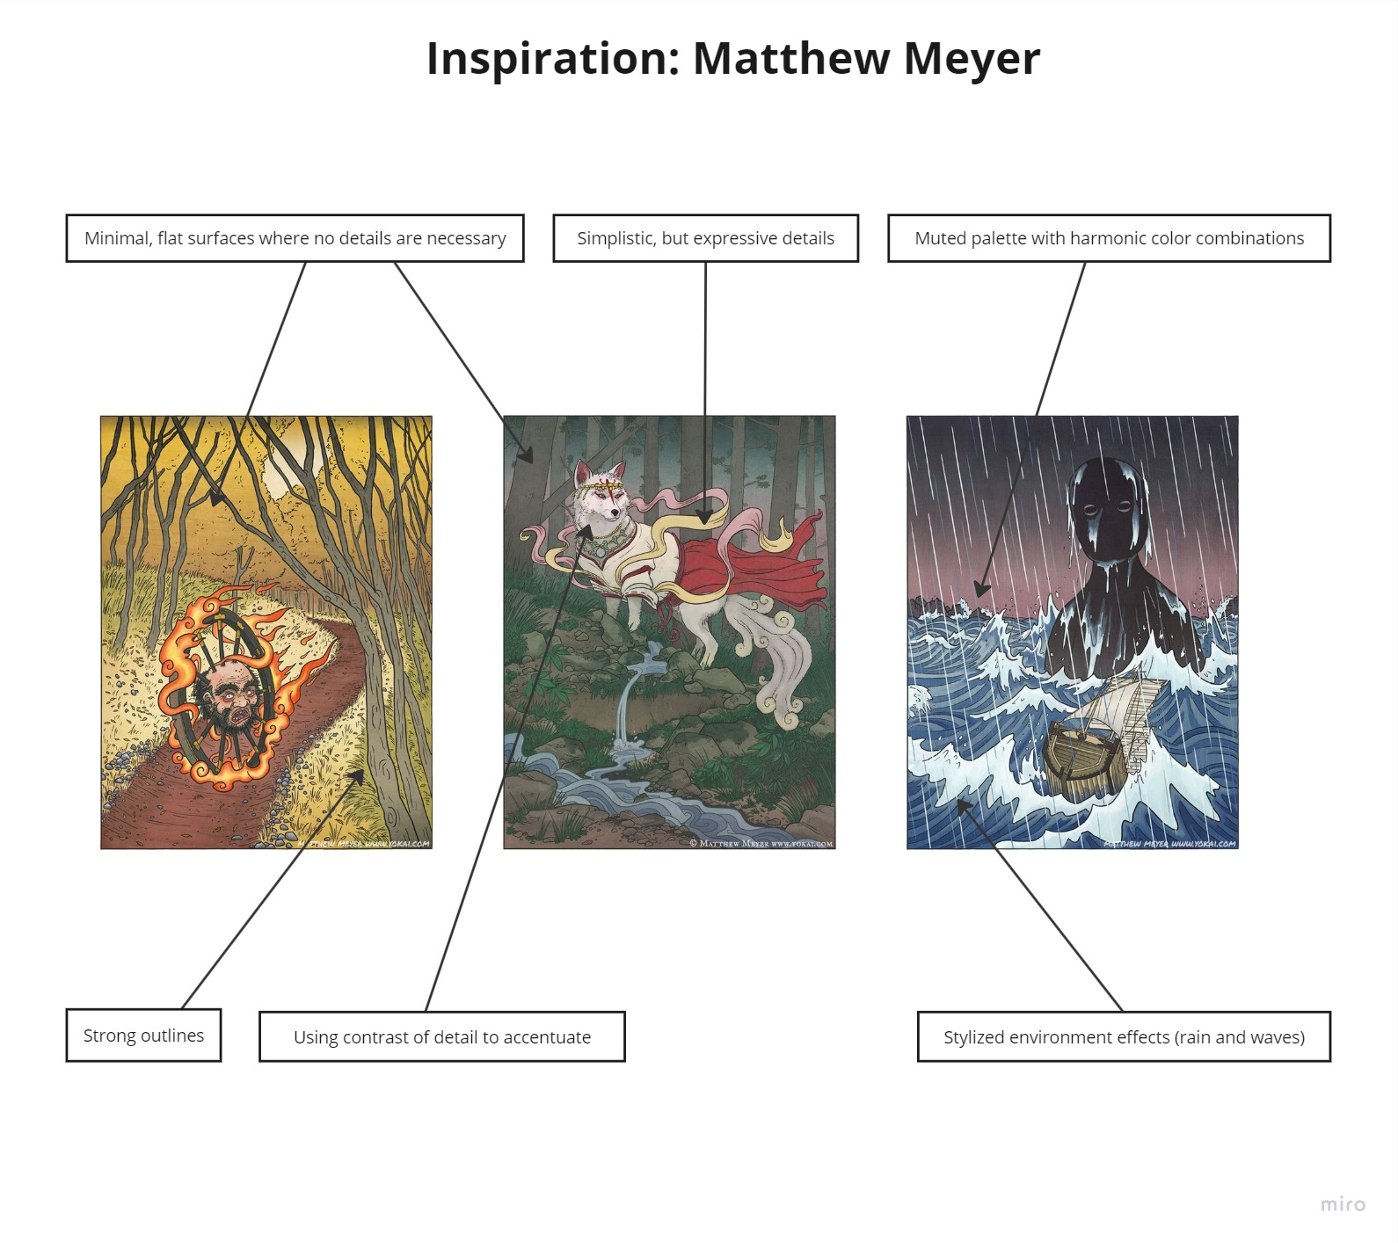
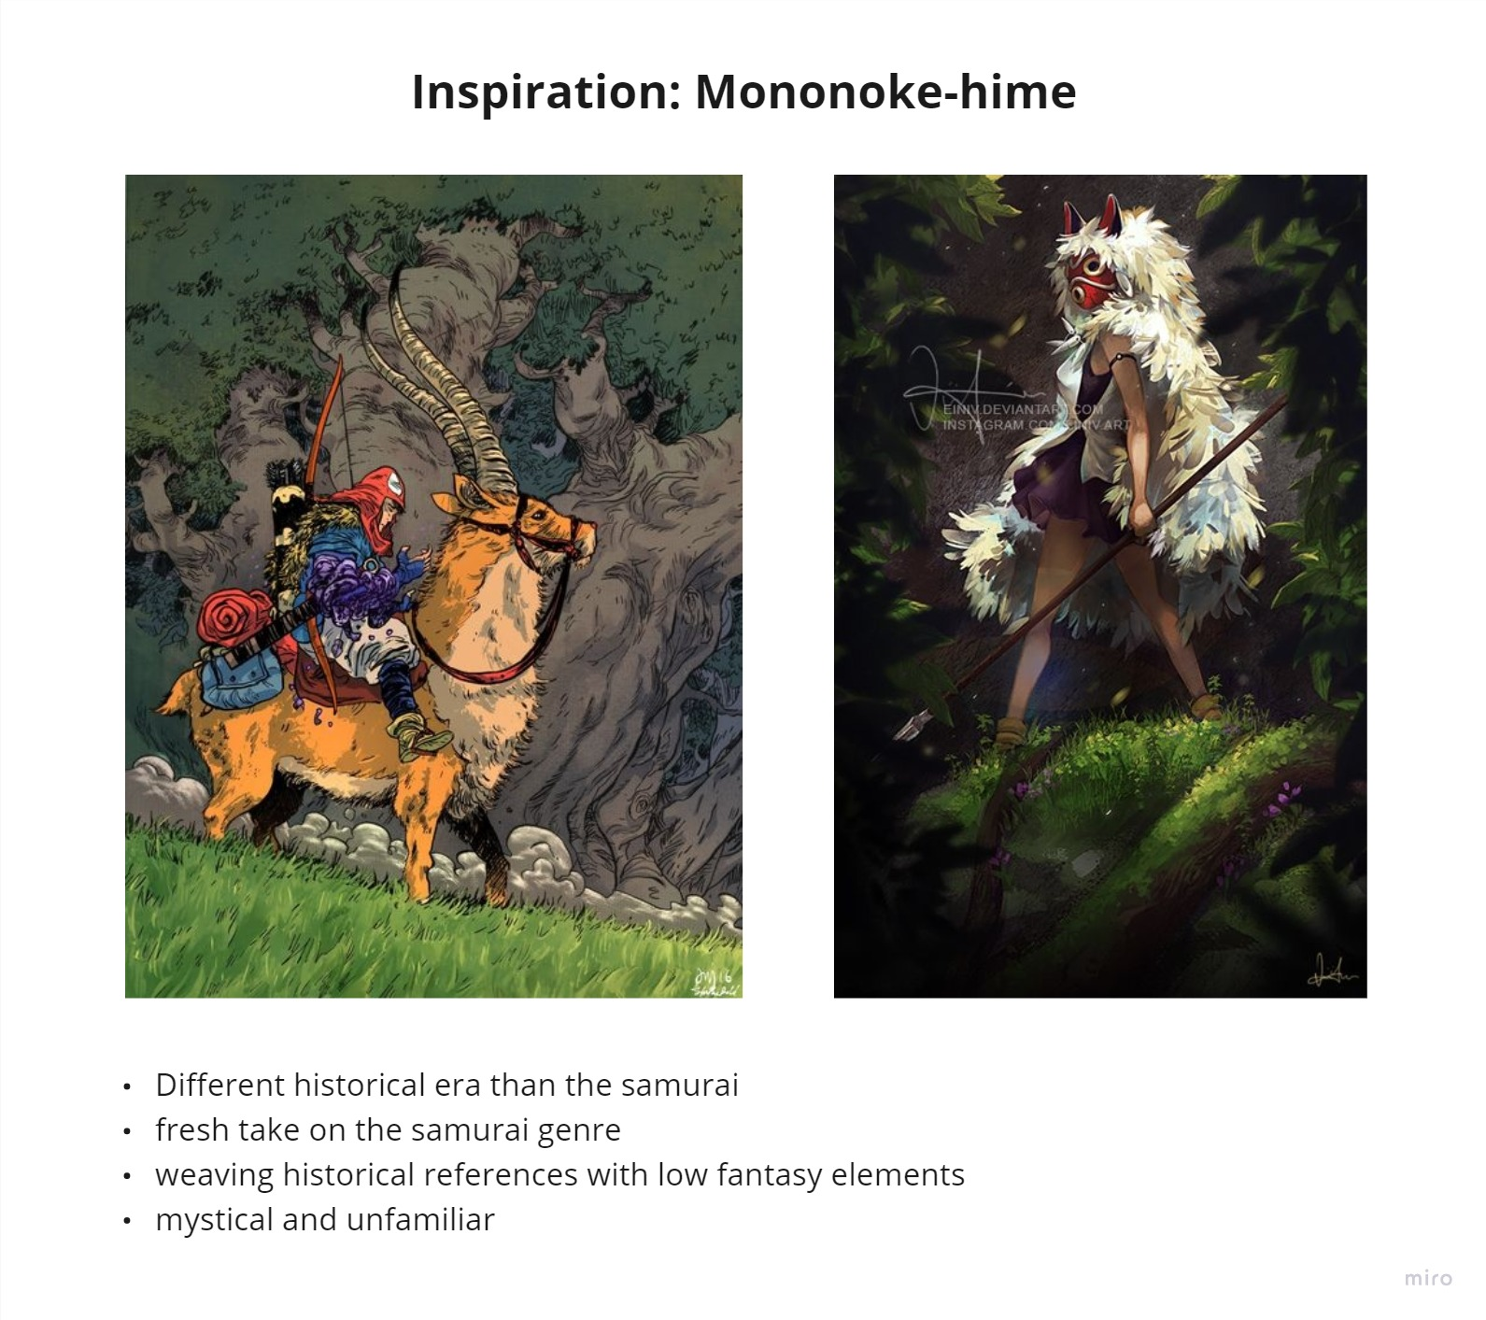

Slide 10
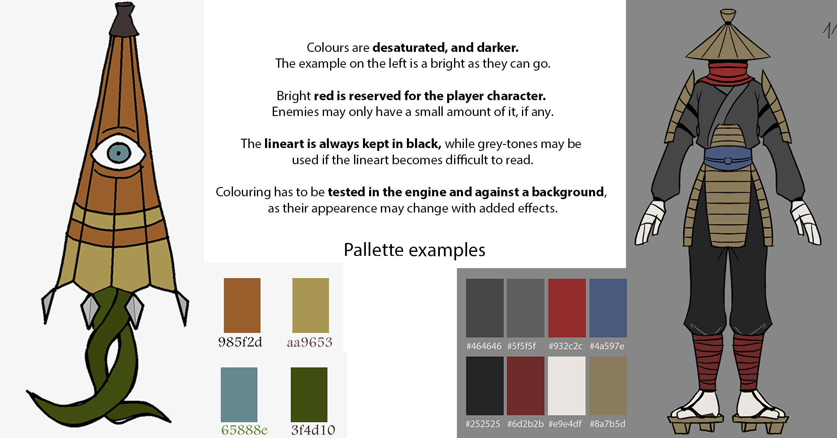
Colour

Slide 11
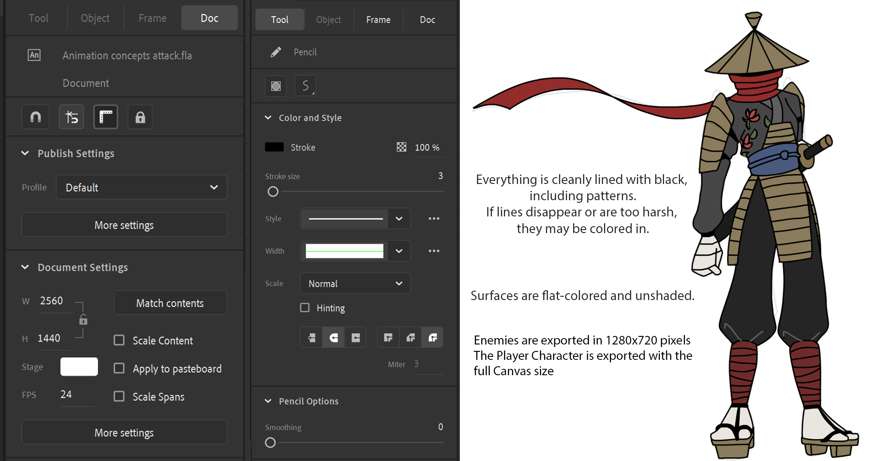
Lines & Canvas

Slide 12
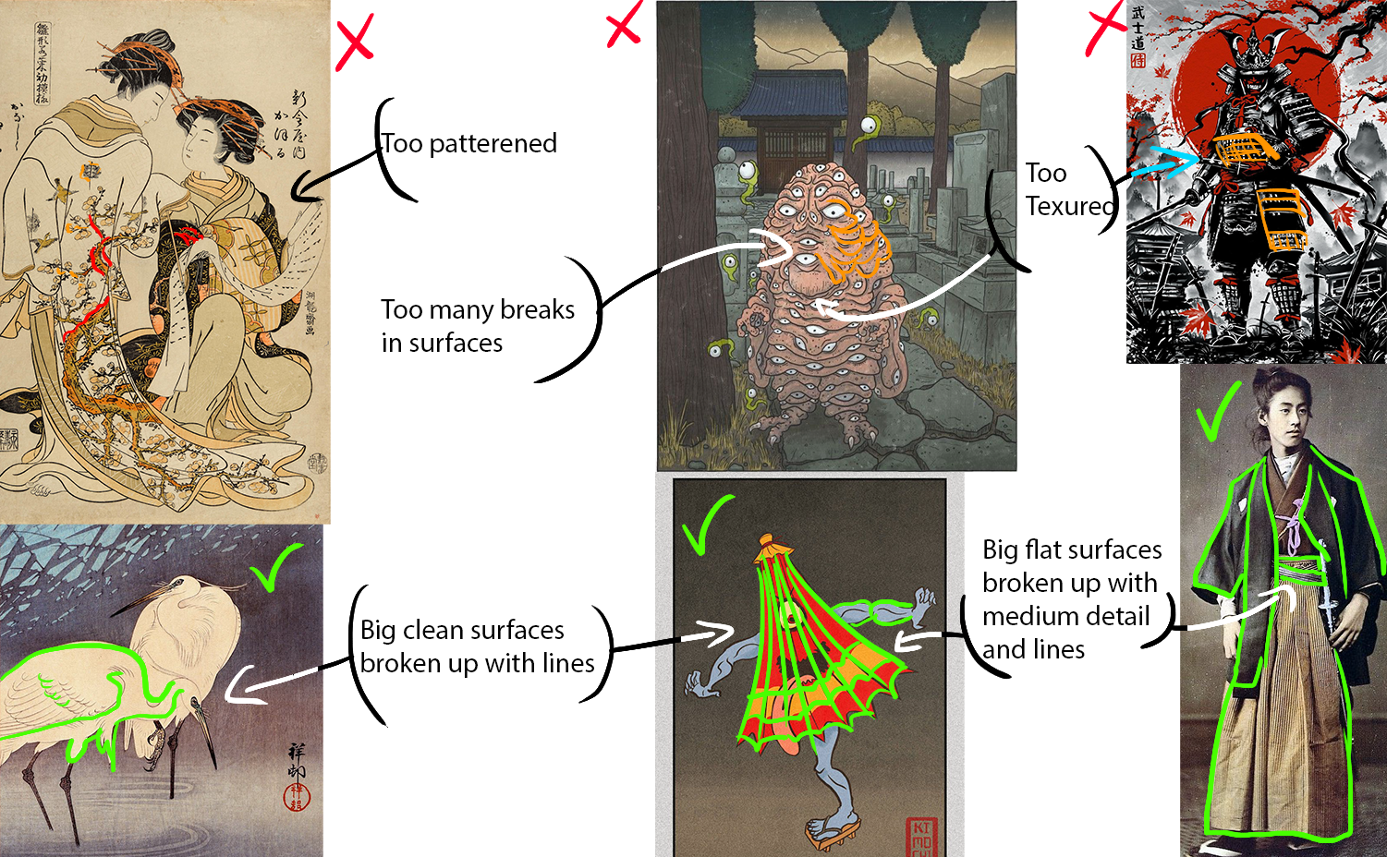
Level of Detail

Slide 13
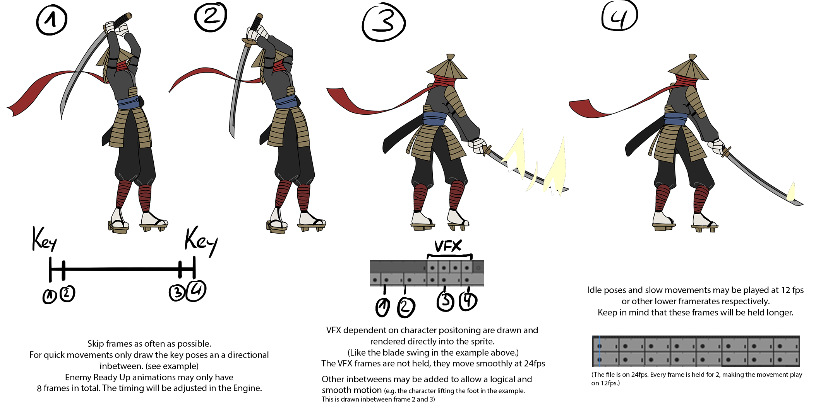
Animation

Slide 15
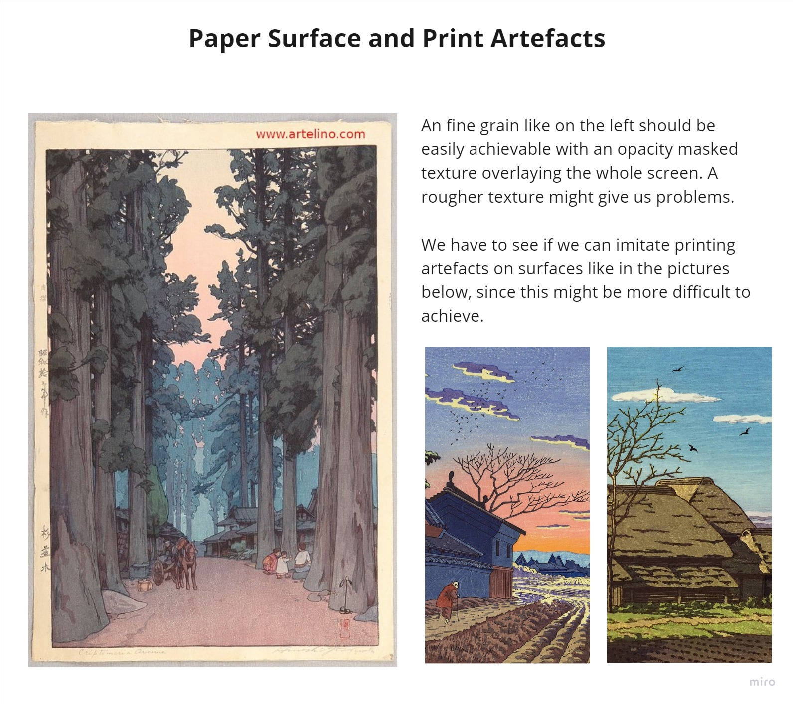

Slide 16
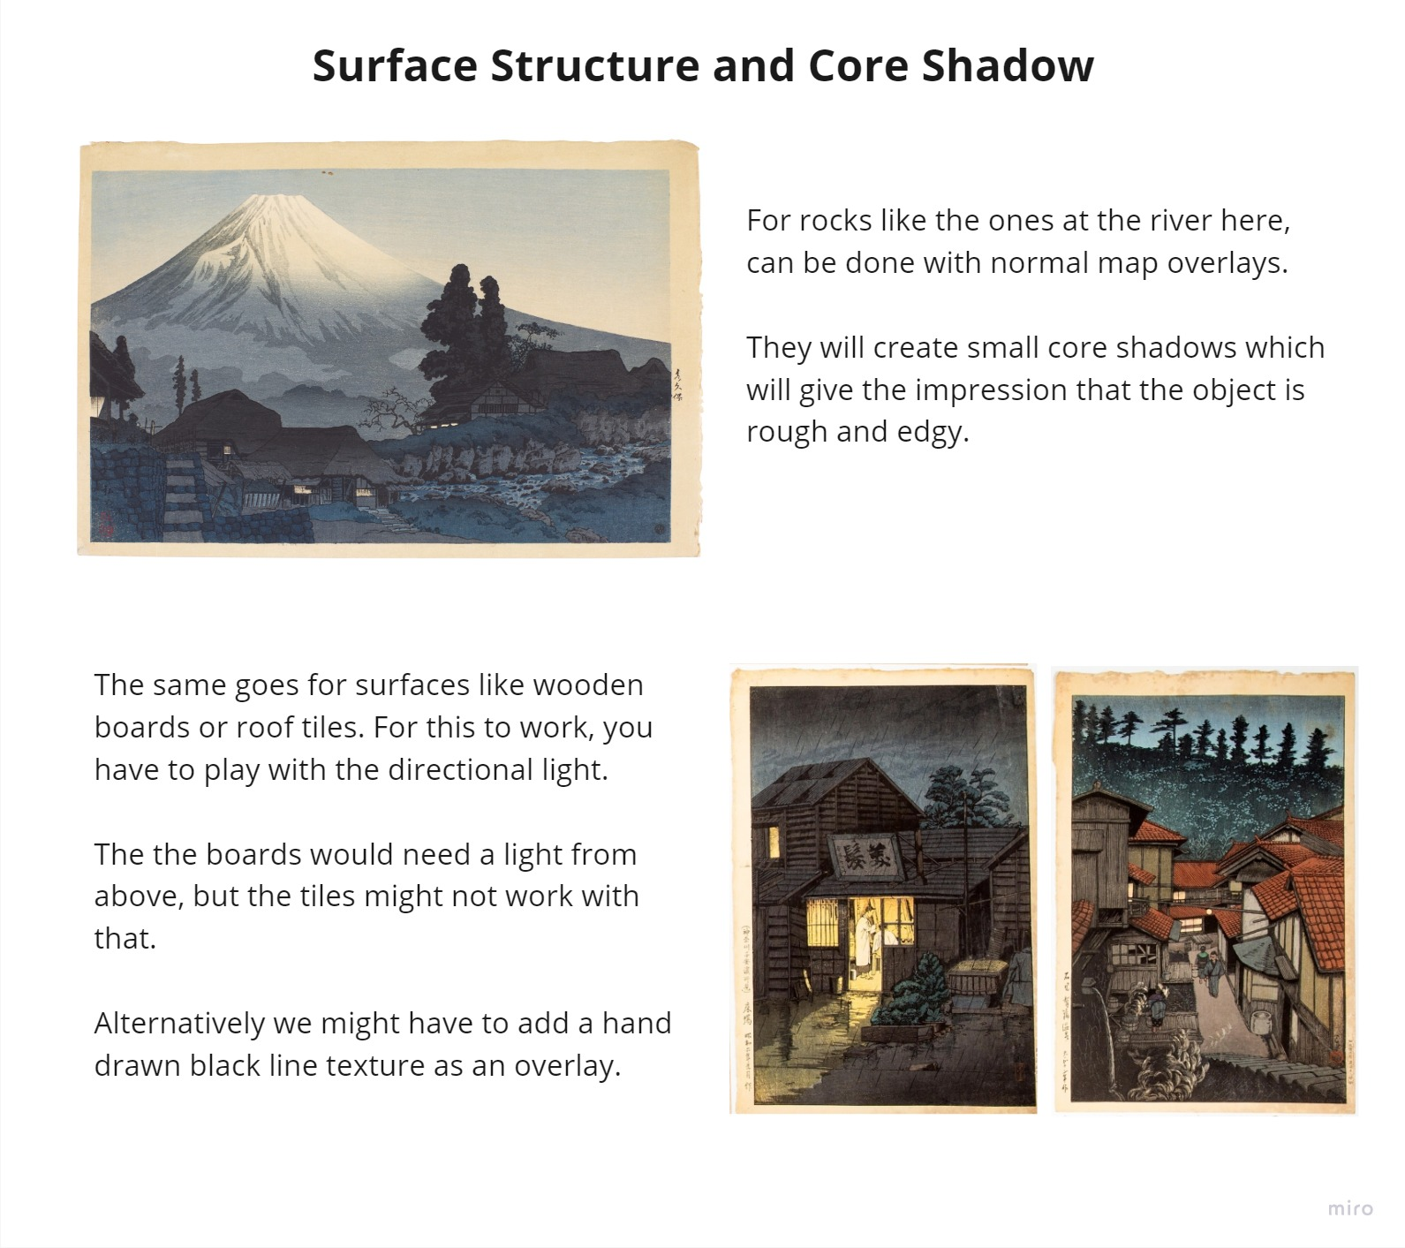

Slide 17
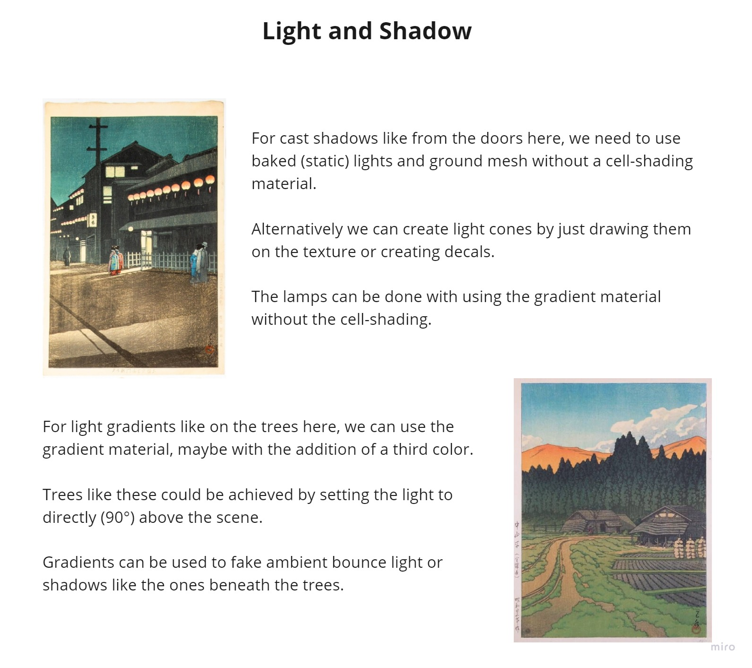

Slide 18
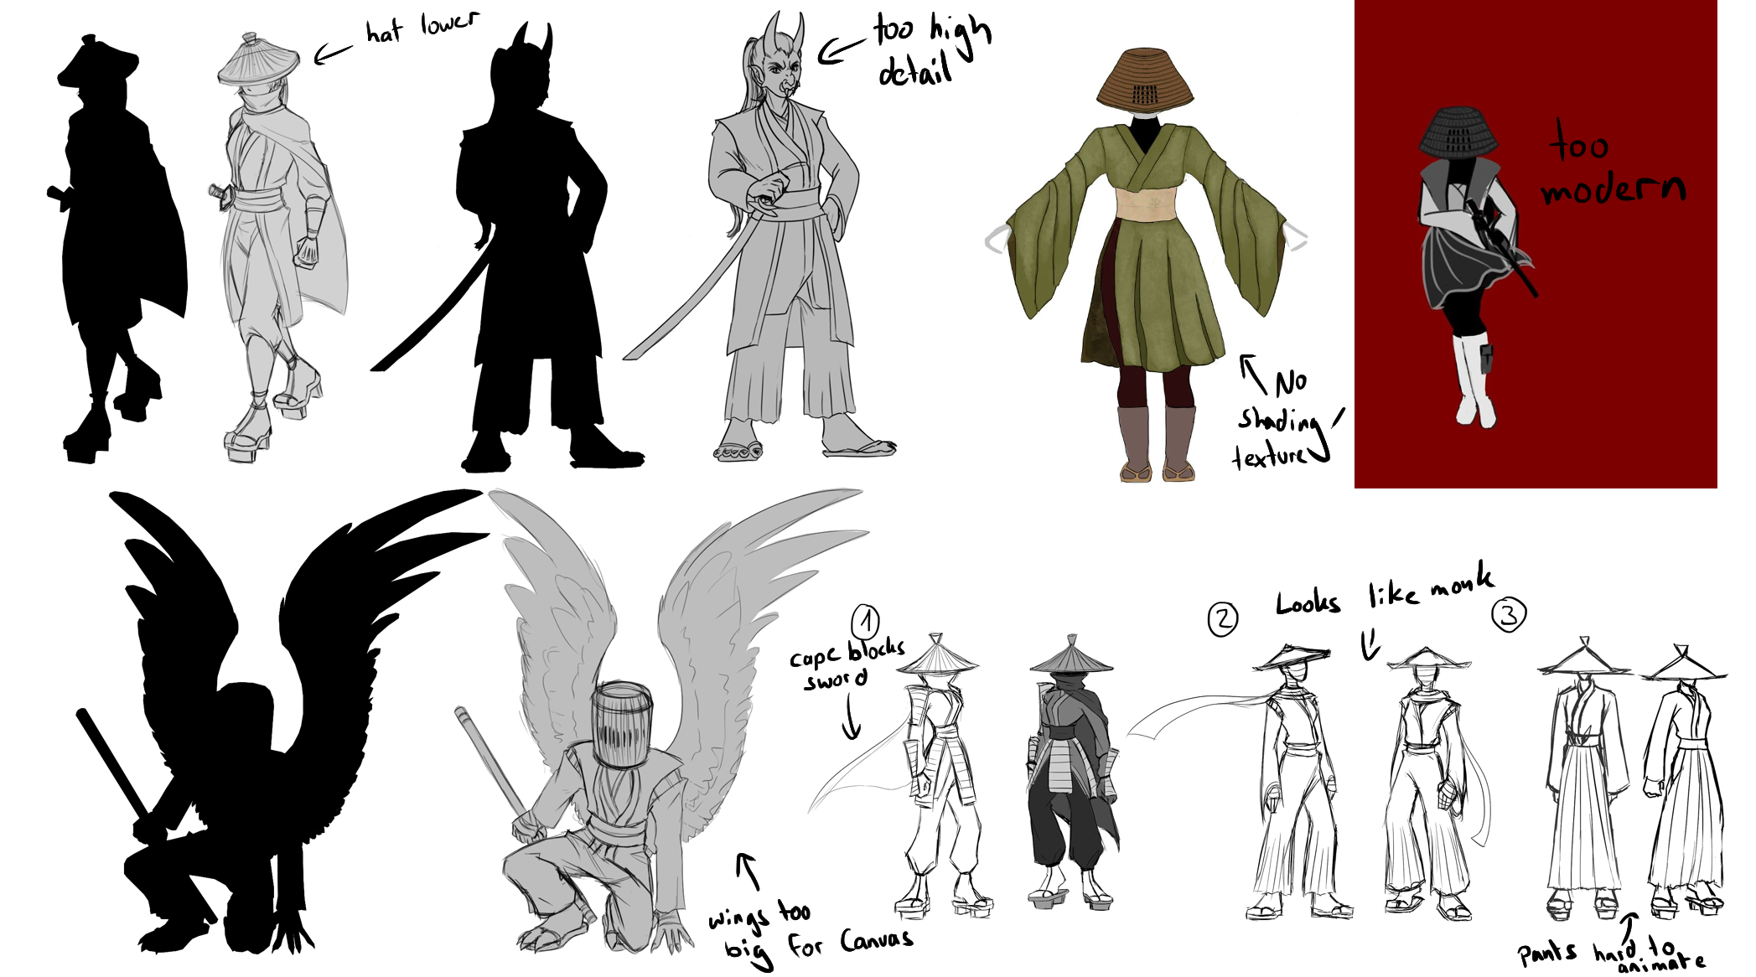
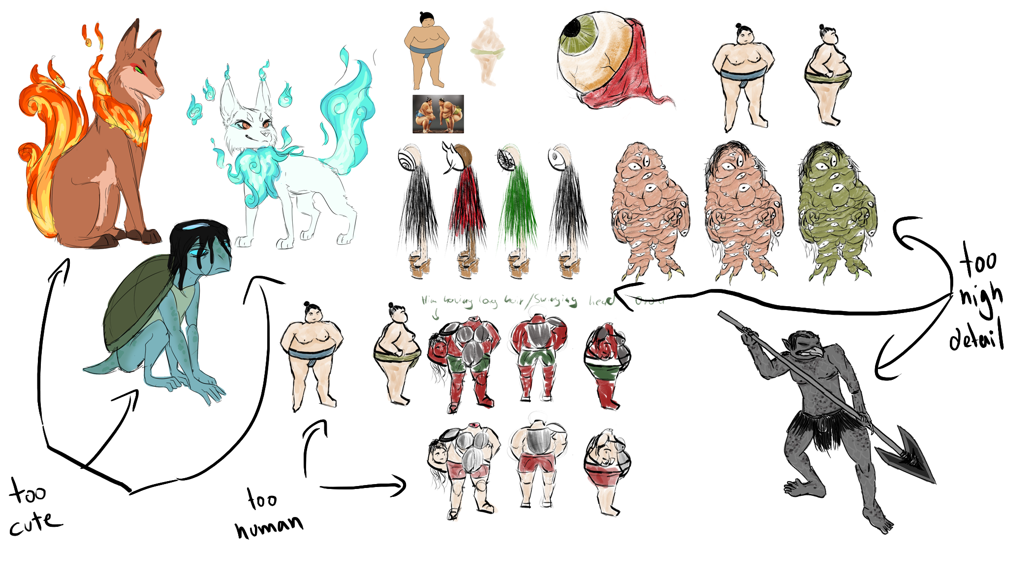
No-Go’s
Character
Enemy

Slide 19
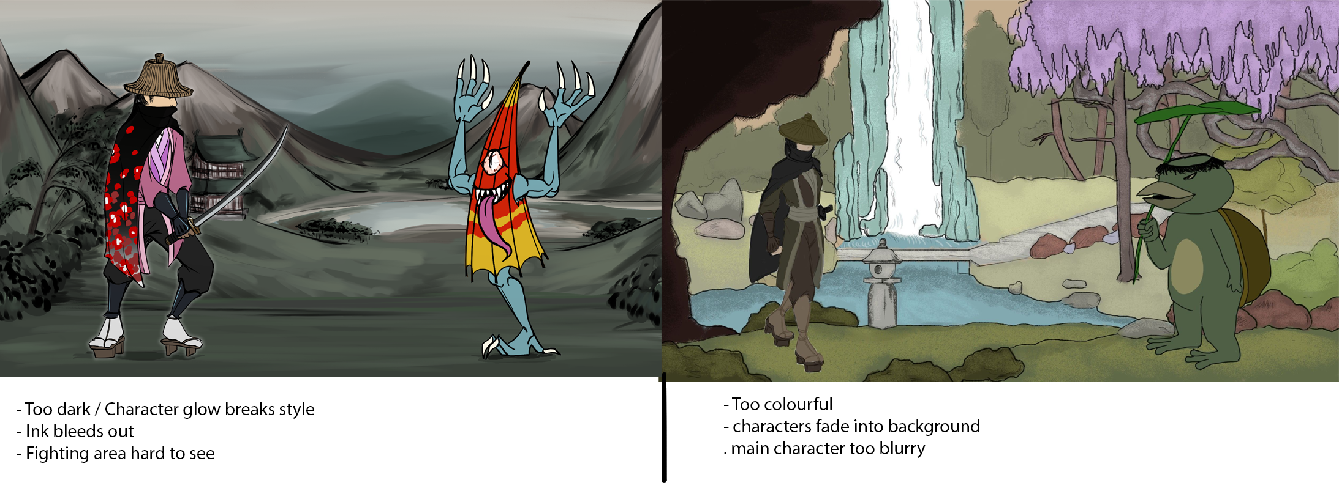
No-Go’s
Backgrounds

Slide 20
UI

Slide 21
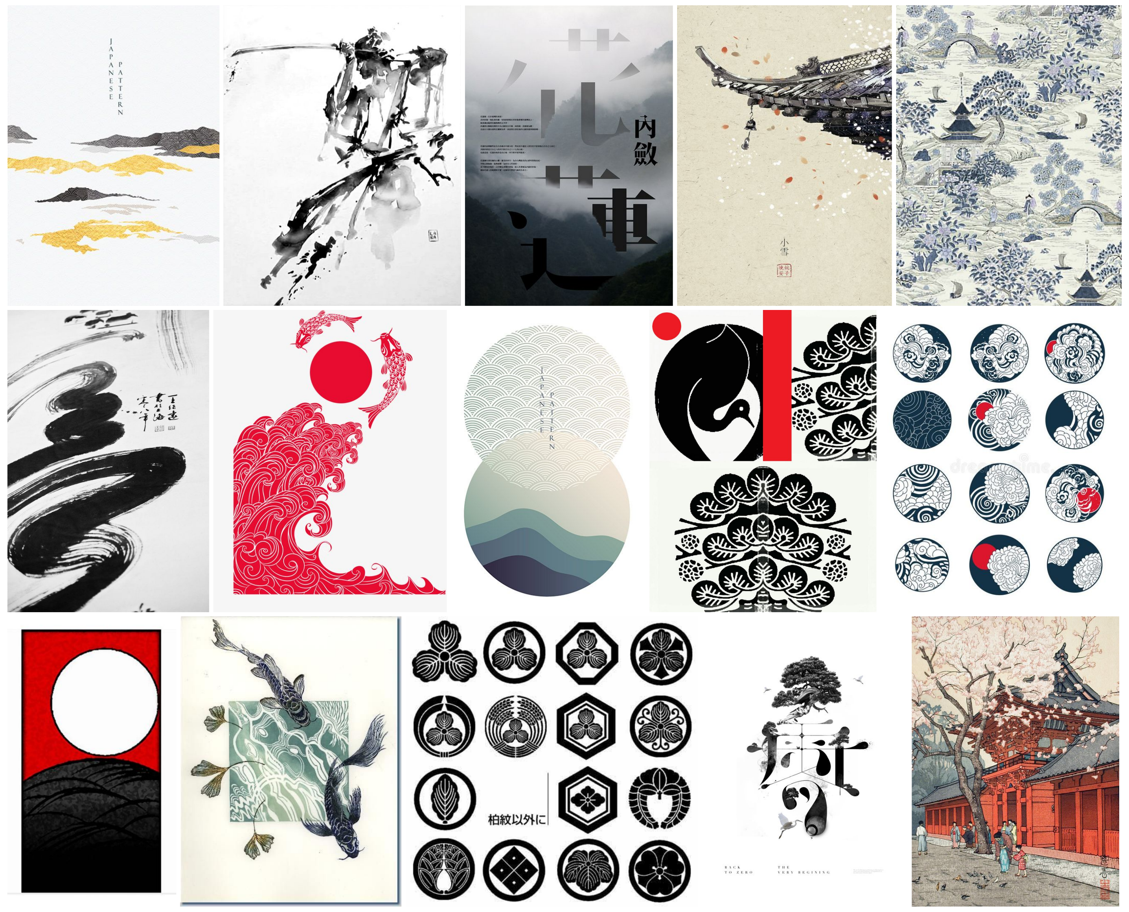
UI Inspiration
A main point we want to stick to throughout the UI is the relation to HANAFUDA CARDS this will create a sense of place and commonality throughout the UI, this will further be supported by a RESTRICTED COLOUR PALETTE.
Keywords
Hanafuda
Calligraphy
Kamon (emblems)

Slide 22
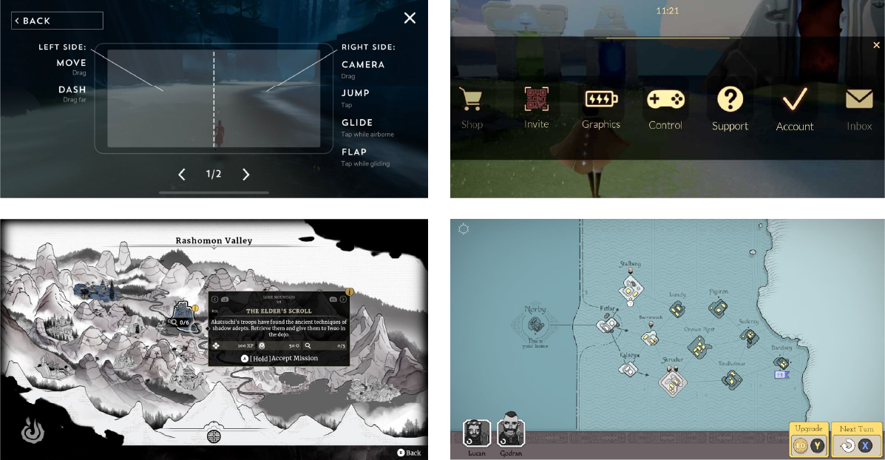
Clear iconography
Refrence works:
The Pathless
Sky: Children of light
Aragami 2
Bad North
Ink Painting style maps

Slide 23


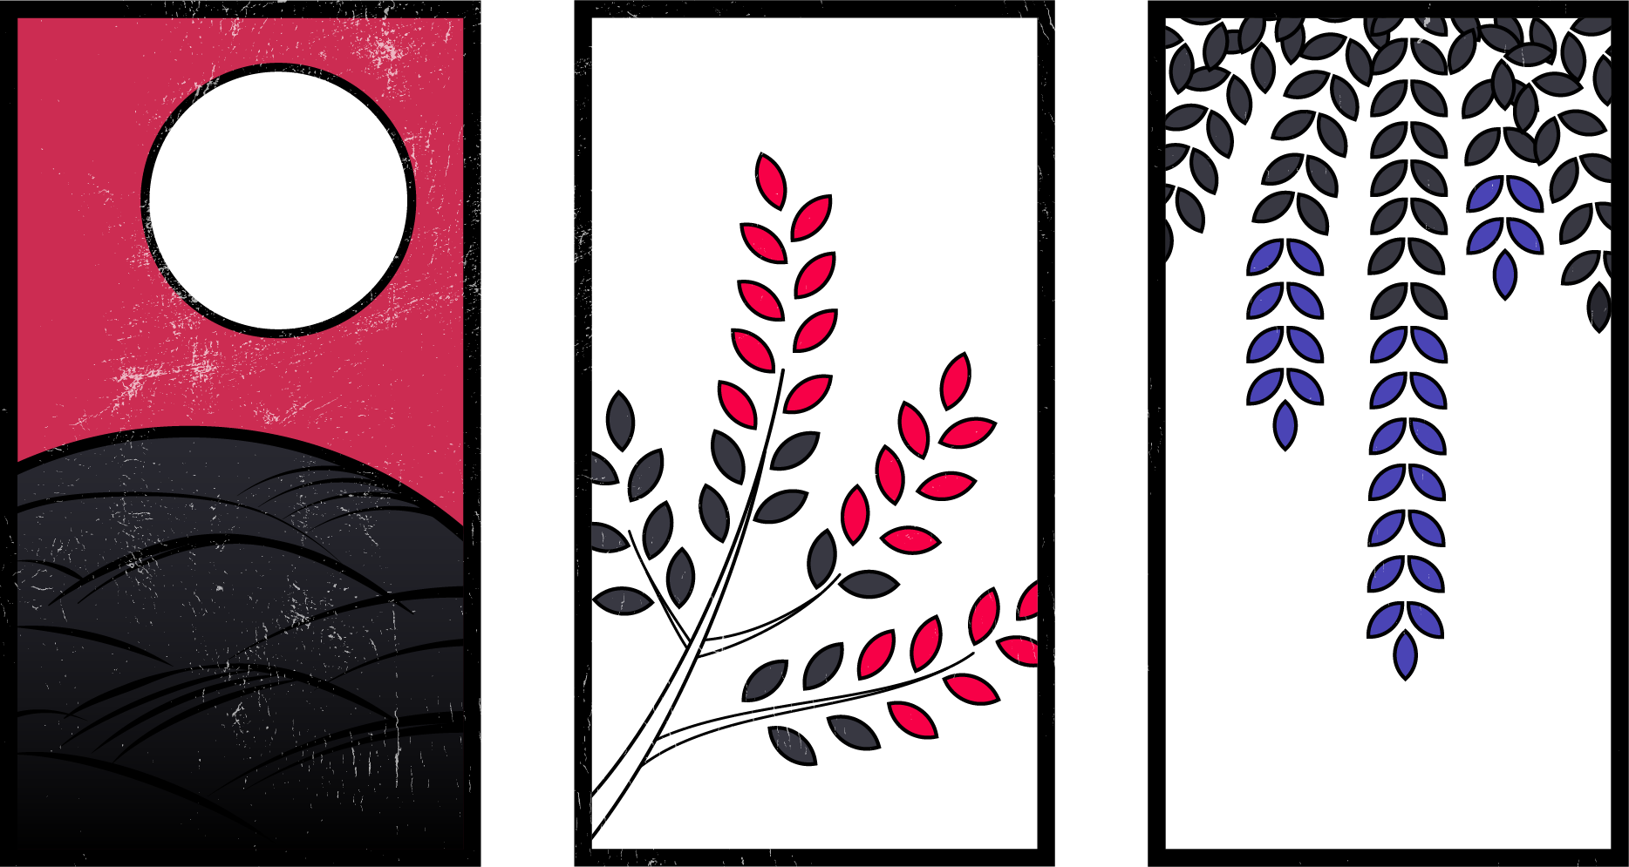
UI STYLE GUIDE
COLOUR PALETTE
HANAFUDA CARDS
These are the core thematic of the UI. Added DISTRESS effect to help it give an aged and rugged look and feel.
While the colour palette will be restrictive hanafuda cards should have more FREEDOM WITH COLOUR choice
FONT
#ffffff
#cc2c52
#282830
Osake.ttf
Reflects the calligraphic elements of the UI
#000000

Slide 24


UI DESIGN SYSTEM
ICON
FLOATING ACTION
COMMON
Outlined Elements
Hanafuda

Slide 25
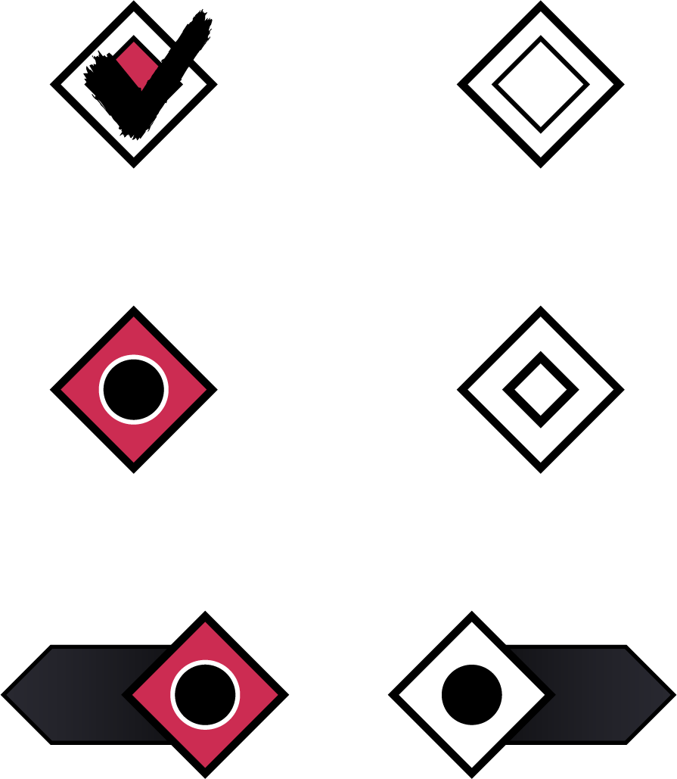

BUTTONS CONT.
CHECKBOX / RADIO / SWITCH
SLIDER
Gradient reinforces forward progression
BRUSH ELEMENTS

Slide 26

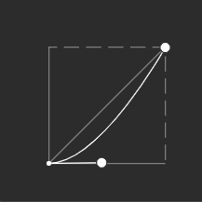
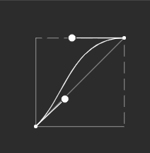
UI Animation Curves
Ease Out
Ease In
Ease In-Out
Main curve can be adjusted to fit needs
Reserved for some card animations
Reserved for switch buttons

Slide 27
VFX

Slide 28
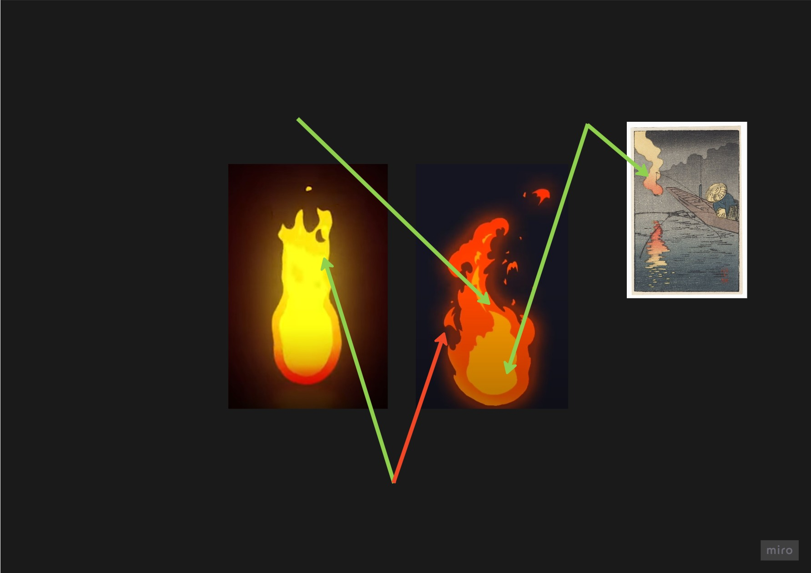
General Environmental Effect Guidelines
Simple two color scheme, maybe some light gradients
Muted Colors like in the wood block prints
Visually, effects should orient on the woodblock print style. Make them flat (2D) and minimalistic. They should look like they could exist on a piece of paper
Generally reduced,
minimalistic effects
that get across what they are supposed to be, but are not taking the attention from the action
Reduced shape complexity, more like in the left than like in the right

Slide 29
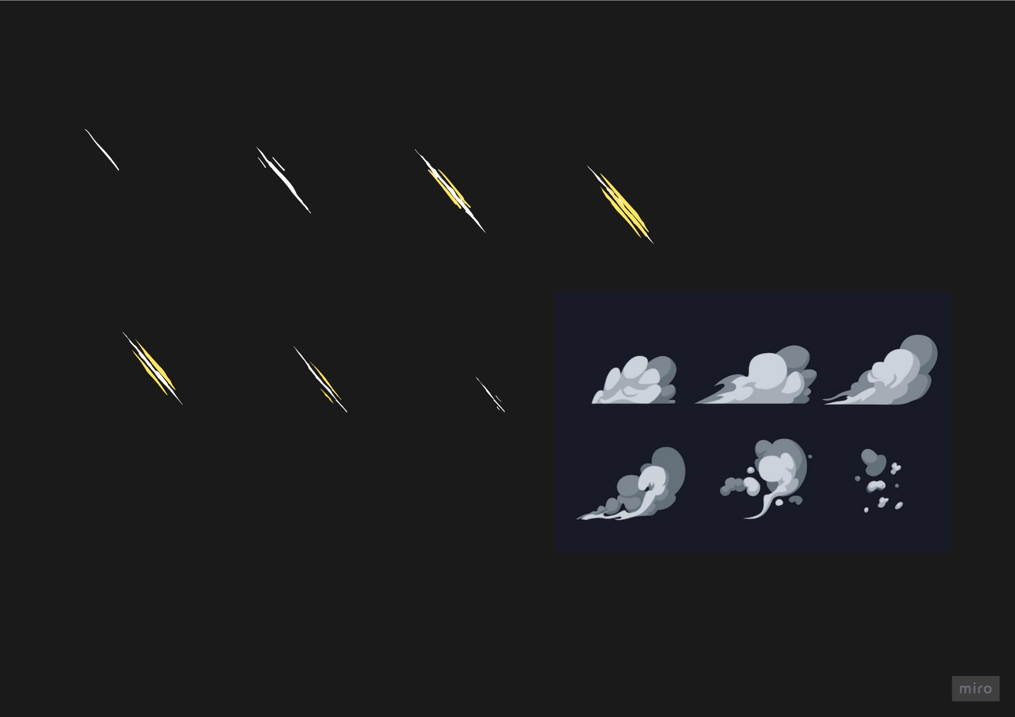
Action Effect Guidelines
Flipbook Animations
Minimal 2D effects
Basecolor + Accent Color
Maybe Shading

Slide 30
Key Words
Stylized, cartoony/toon, cel-shaded
Traditional 2d
flipbook animations / Sub UV animations

Slide 31
Technical Details
Details | Pipelines | Asset Lists

Slide 32
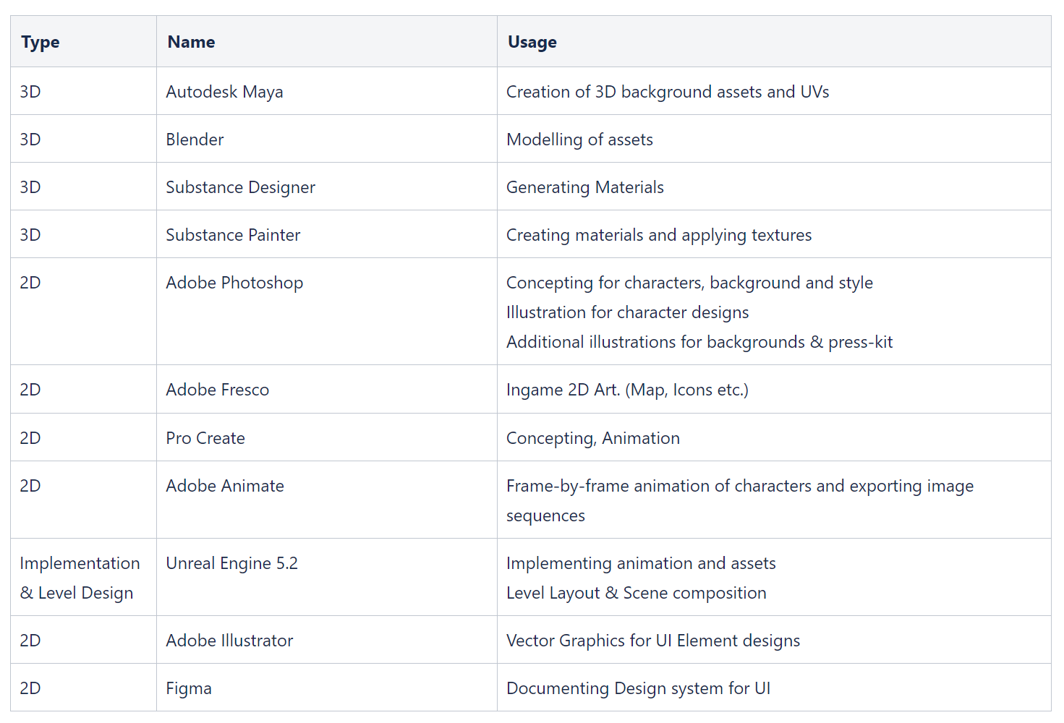
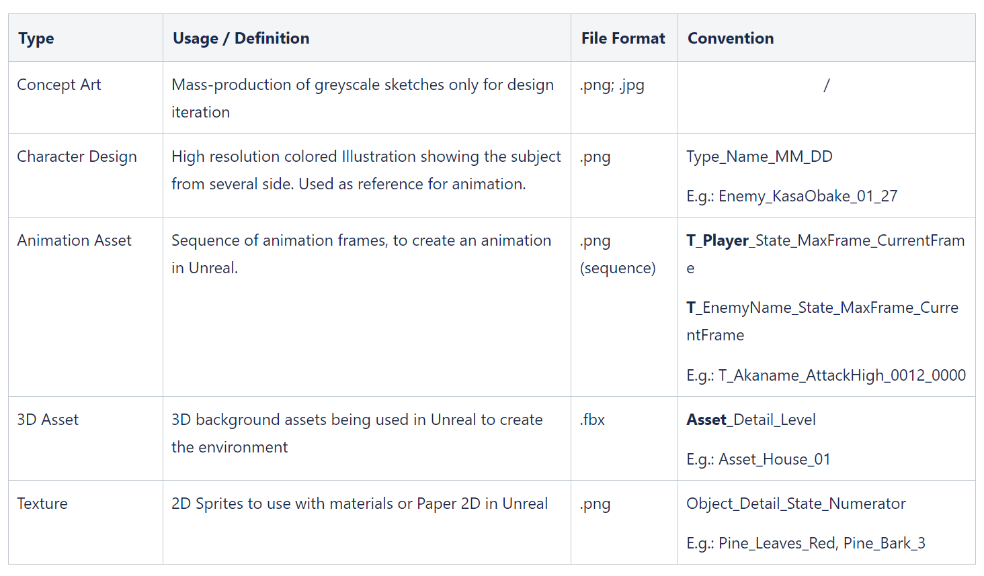
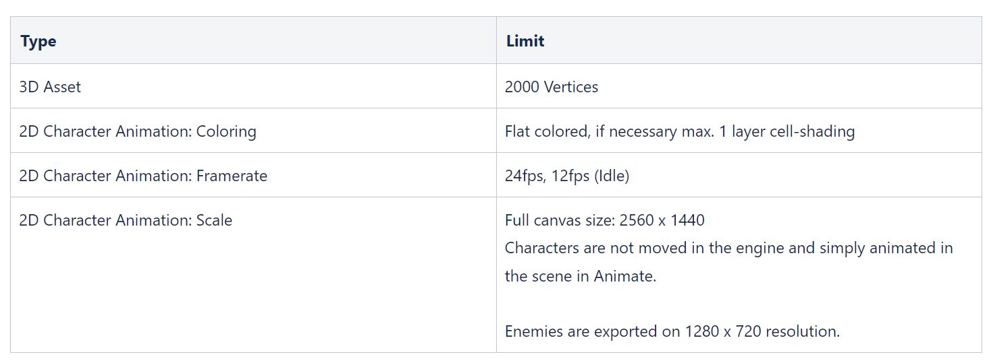
Details
Used Programs
Naming Conventions
Technical Limitations

Slide 33
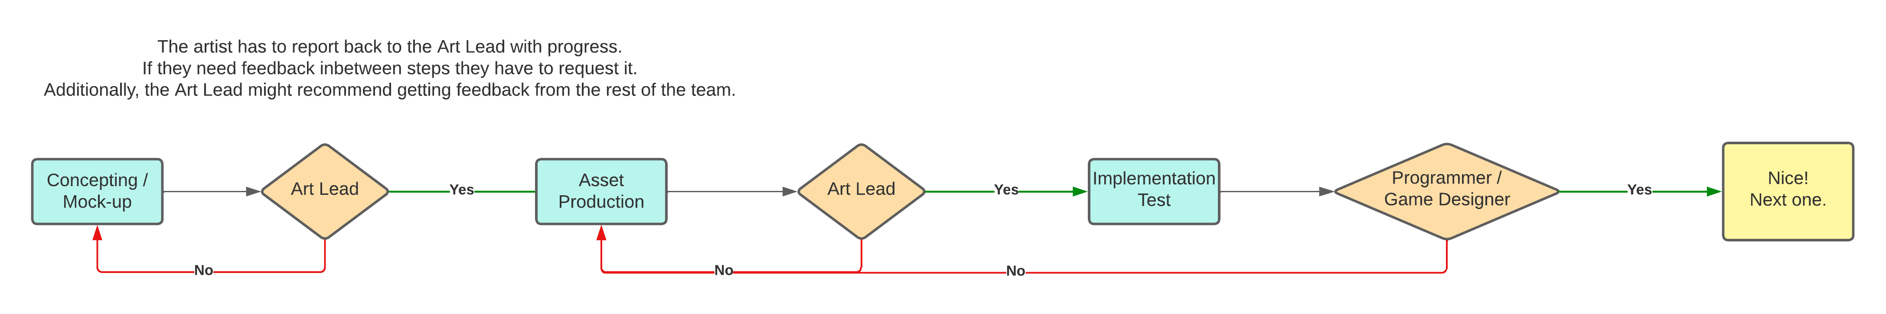
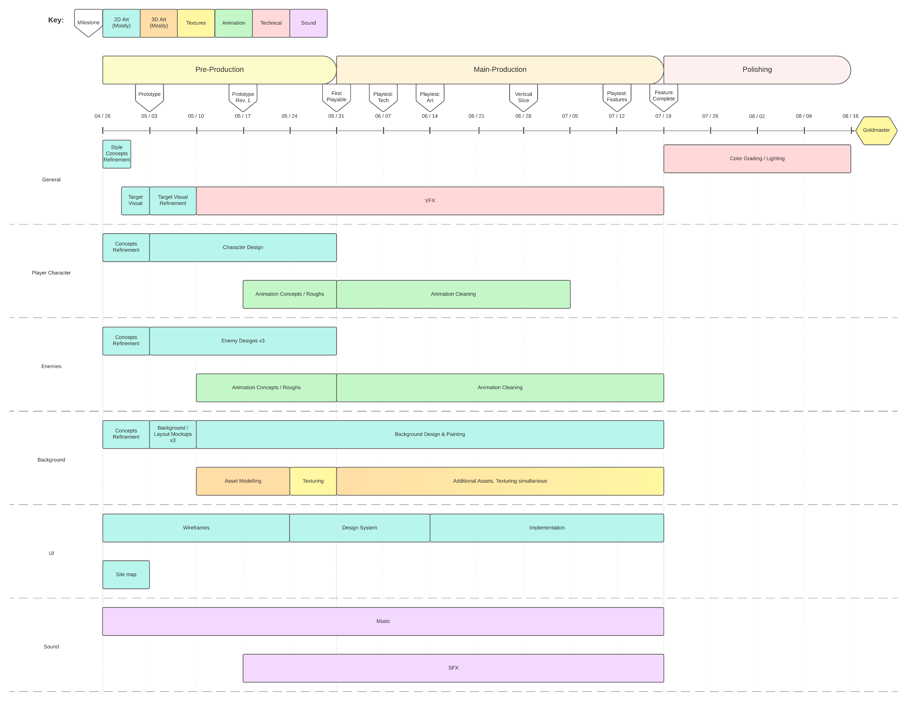
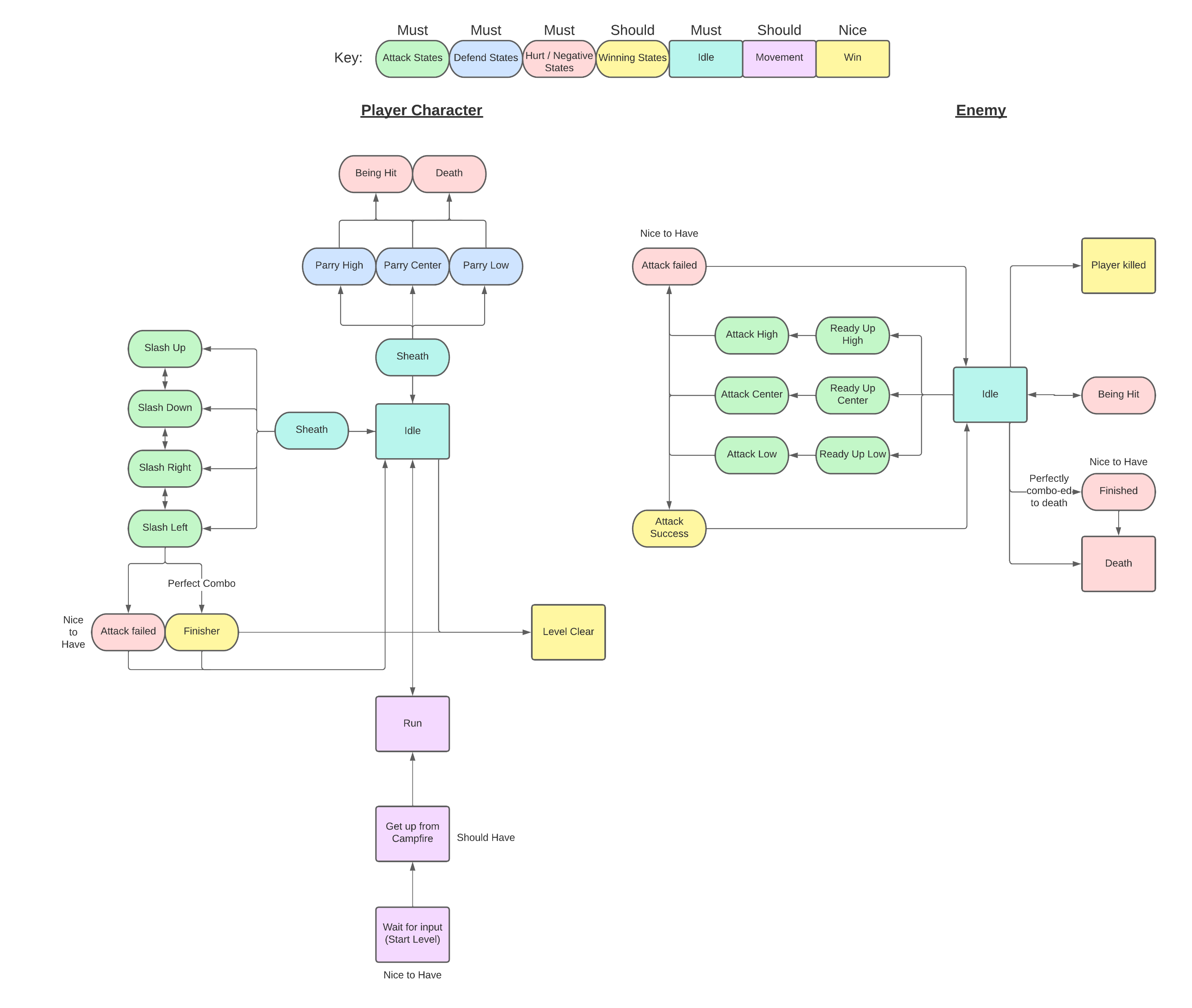
Pipelines & Planning
PBS - Art
State Machines

Slide 34
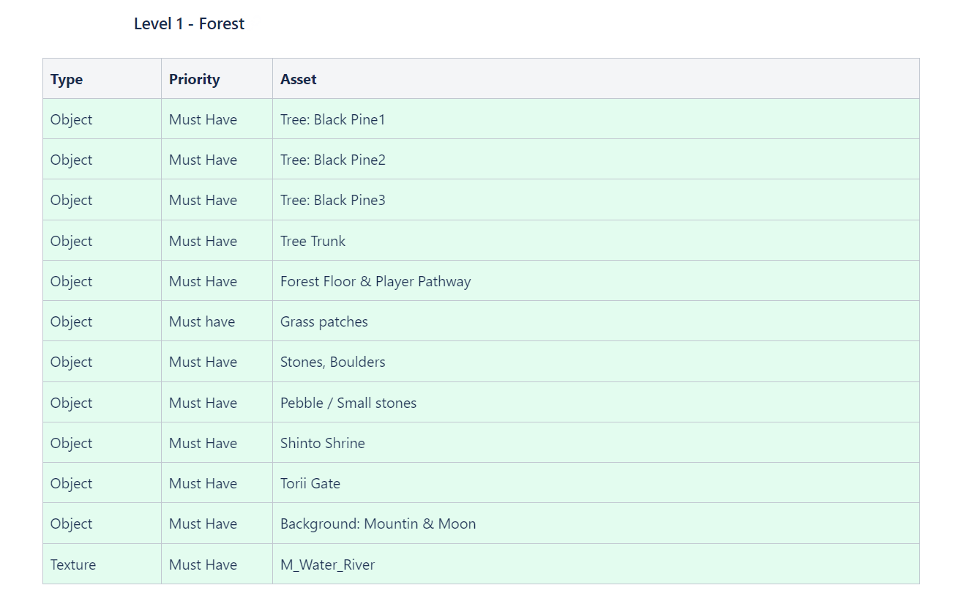
Asset List – 3D

Slide 35
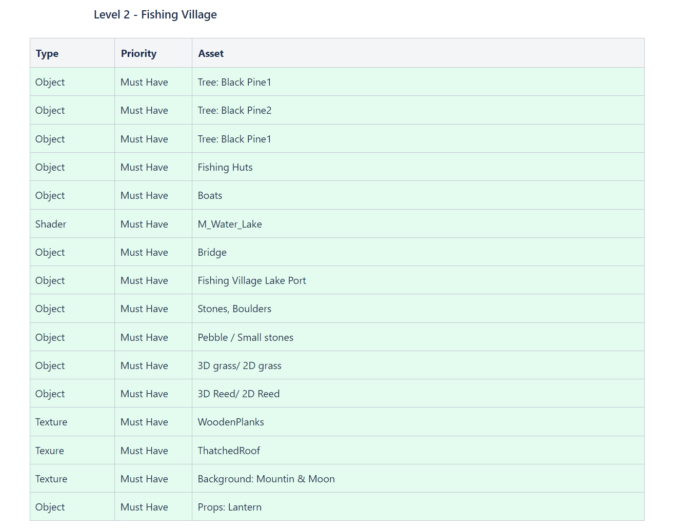
Asset List – 3D

Slide 36
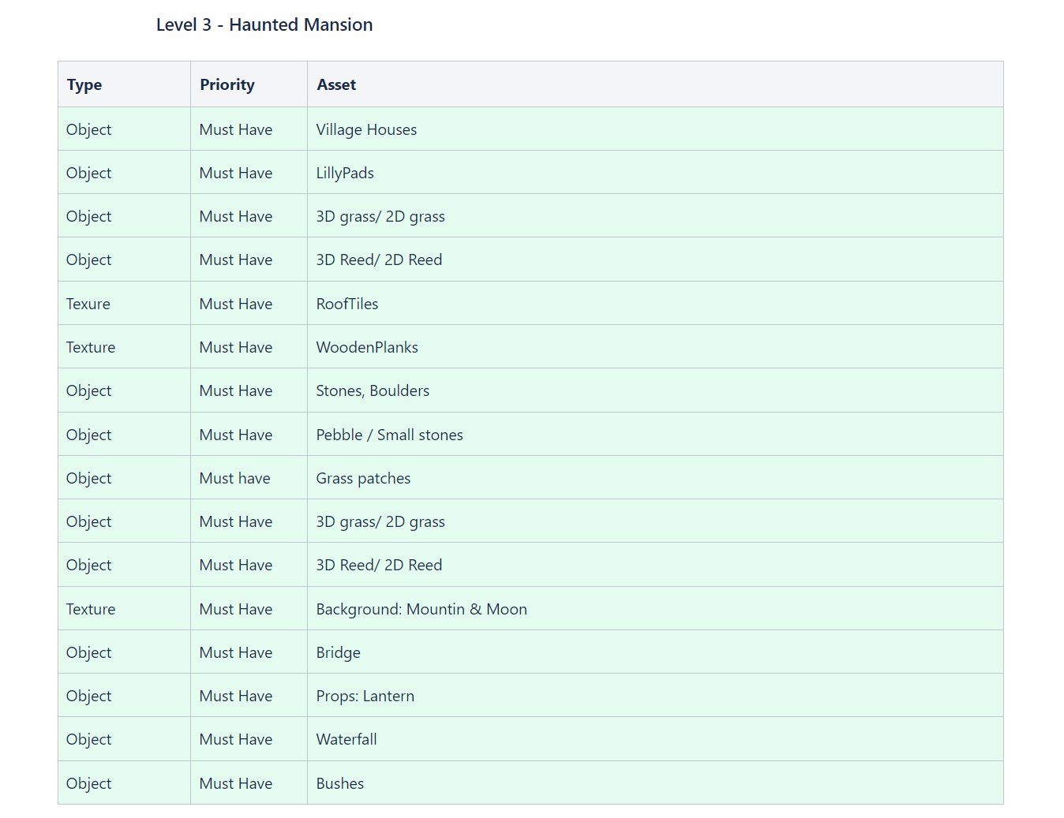
Asset List – 3D

Slide 37
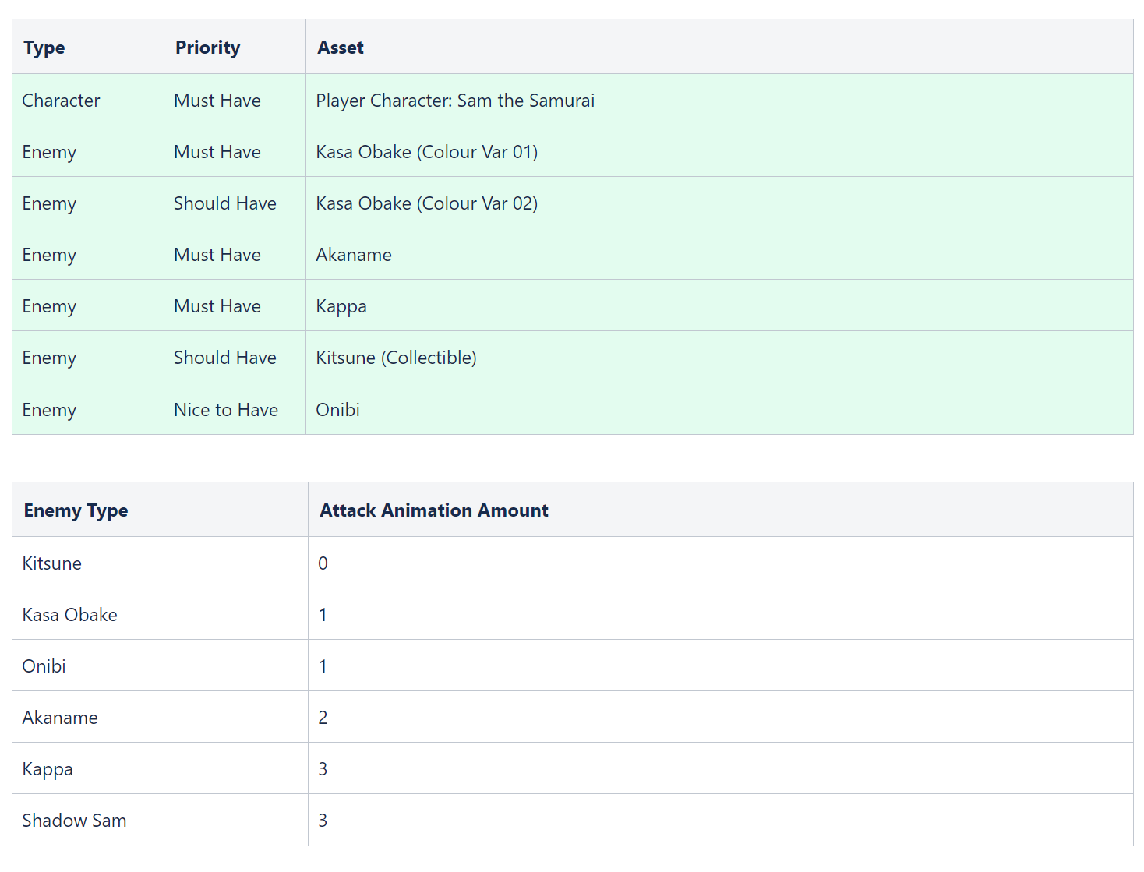
Asset List – 2D

Slide 38
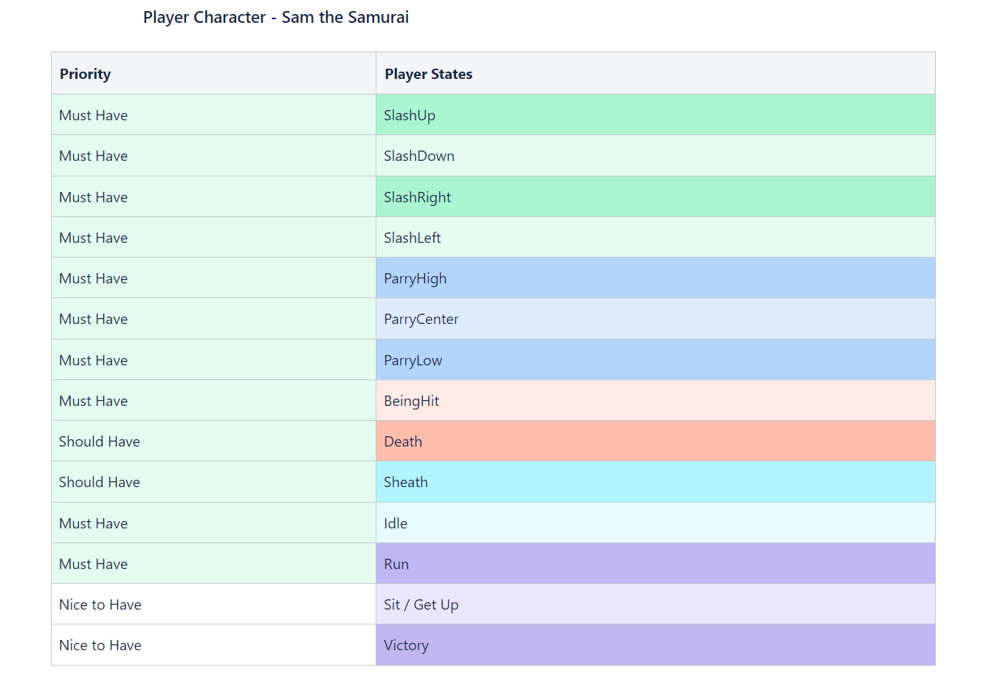
Asset List – 2D

Slide 39
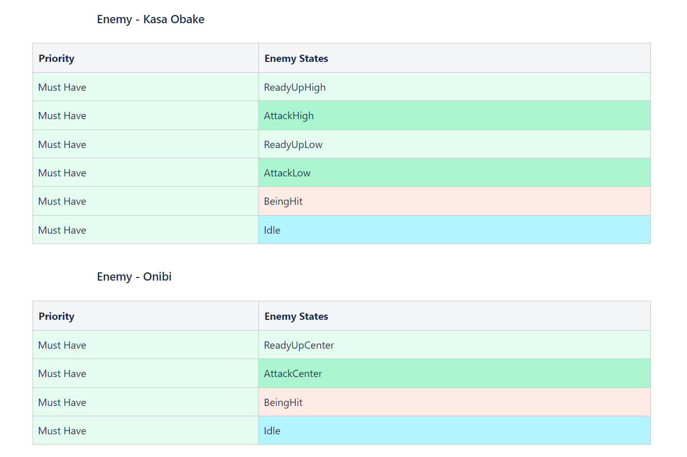
Asset List – 2D

Slide 40
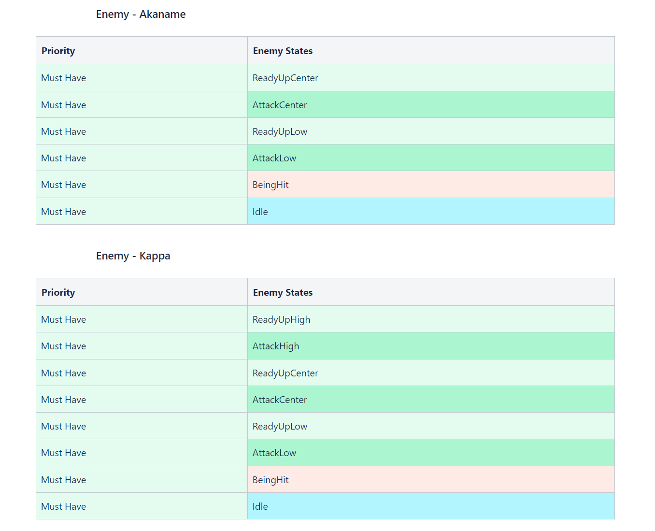
Asset List – 2D

Slide 41
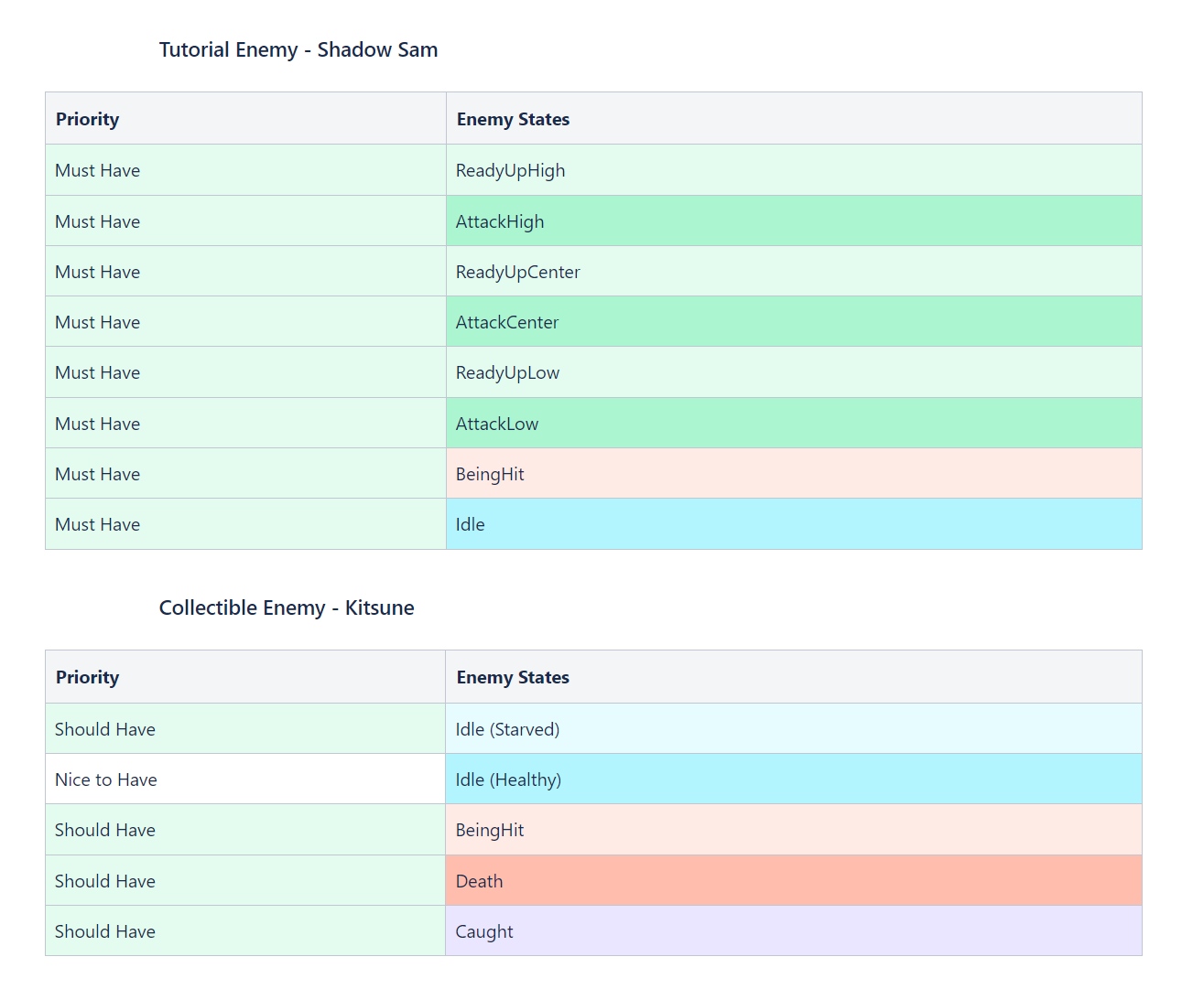
Asset List – 2D

Slide 42
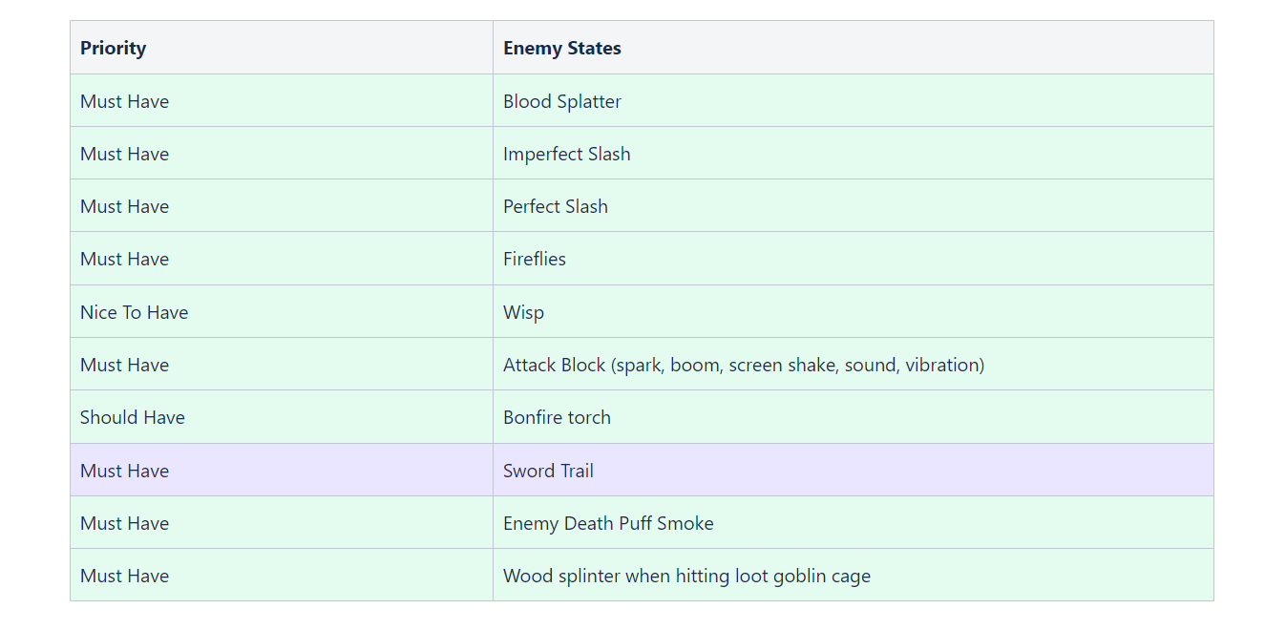
Asset List – VFX

